Slide 1
Computer Organization and Architecture (AT70.01)
Comp. Sc. and Inf. Mgmt.
Asian Institute of Technology
Instructor: Dr. Sumanta Guha
Slide Sources: Patterson &
Hennessy COD book website
(copyright Morgan Kaufmann)
adapted and supplemented

Slide 2
COD Ch. 5
The Processor: Datapath and
Control

Slide 3
Implementing MIPS
We're ready to look at an implementation of the MIPS instruction set
Simplified to contain only
  arithmetic-logic instructions: add, sub, and, or, slt
  memory-reference instructions: lw, sw
  control-flow instructions: beq, j
6 bits
5 bits
5 bits
5 bits
5 bits
6 bits
op
rs
rt
rd
shamt
funct
R-Format
6 bits
5 bits
5 bits
16 bits
op
rs
rt
offset
I-Format
6 bits
26 bits
J-Format
op
address

Slide 4
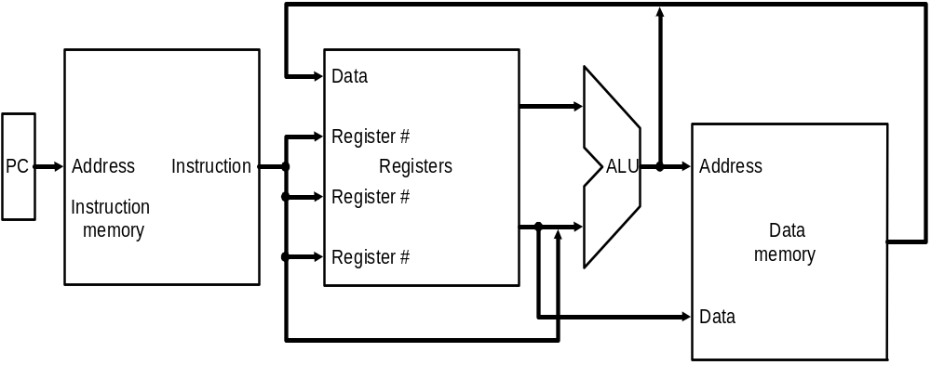
Implementing MIPS: the Fetch/Execute Cycle
High-level abstract view of fetch/execute implementation
  use the program counter (PC) to read instruction address
  fetch the instruction from memory and increment PC
  use fields of the instruction to select registers to read
  execute depending on the instruction
  repeat…

Slide 5
Overview: Processor Implementation Styles
Single Cycle
  perform each instruction in 1 clock cycle
  clock cycle must be long enough for slowest instruction; therefore,
  disadvantage: only as fast as slowest instruction
Multi-Cycle
  break fetch/execute cycle into multiple steps
  perform 1 step in each clock cycle
  advantage: each instruction uses only as many cycles as it needs
Pipelined
  execute each instruction in multiple steps
  perform 1 step / instruction in each clock cycle
  process multiple instructions in parallel – assembly line

Slide 6
Functional Elements
Two types of functional elements in the hardware:
  elements that operate on data (called combinational elements)
  elements that contain data (called state or sequential elements)

Slide 7
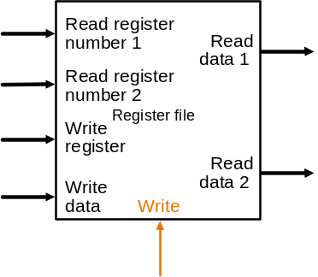
State Elements on the Datapath: Register File
Registers are implemented with arrays of D-flipflops
Clock
5 bits
32 bits
5 bits
5 bits
32 bits
32 bits
Control signal
Register file with two read ports and
one write port

Slide 8
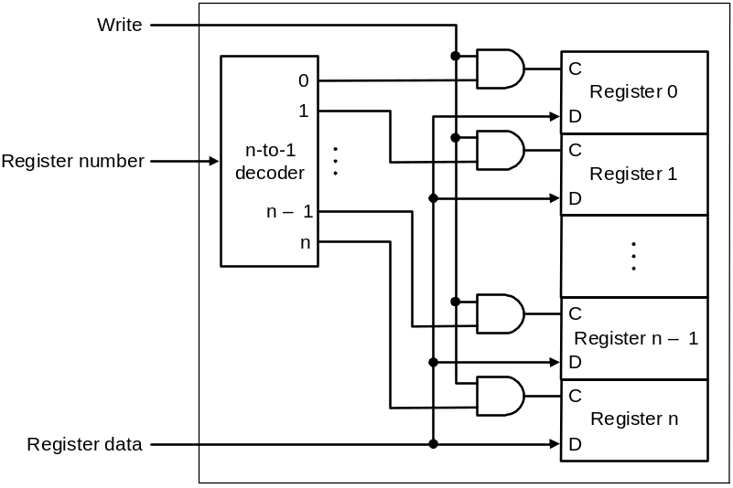
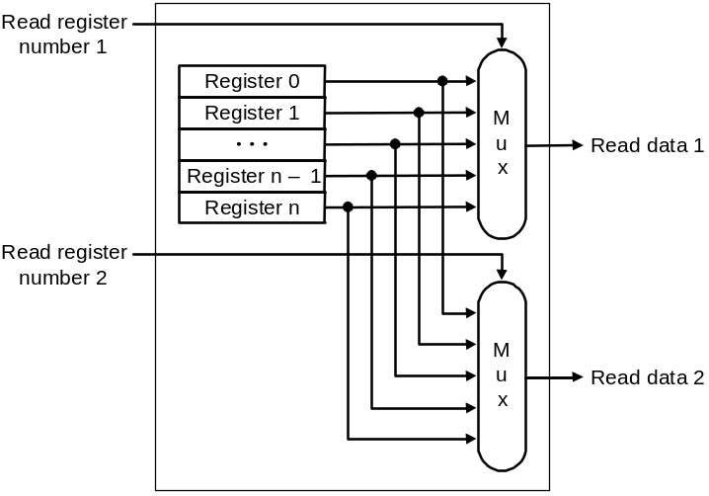
State Elements on the Datapath: Register File
Port implementation:
Clock
Clock
Read ports are implemented
with a pair of multiplexors – 5
bit multiplexors for 32 registers
Write port is implemented using
a decoder – 5-to-32 decoder for
32 registers. Clock is relevant to
write as register state may change
only at clock edge

Slide 9
Single-cycle Implementation of MIPS
Our first implementation of MIPS will use a single long clock cycle for every instruction
This approach is not practical as it is much slower than a multicycle implementation where different instruction classes can take different numbers of cycles
  in a single-cycle implementation every instruction must take the same amount of time as the slowest instruction
  in a multicycle implementation this problem is avoided by allowing quicker instructions to use fewer cycles
Even though the single-cycle approach is not practical it is simple and useful to understand first

Slide 10
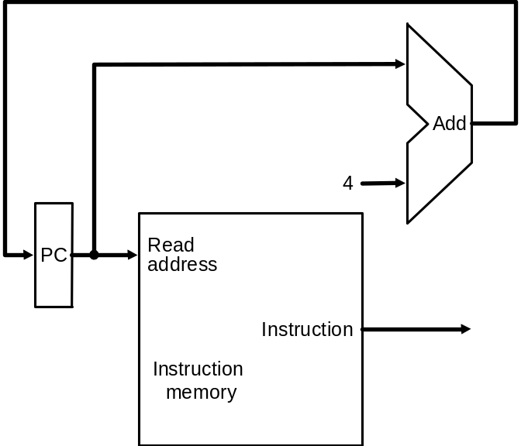
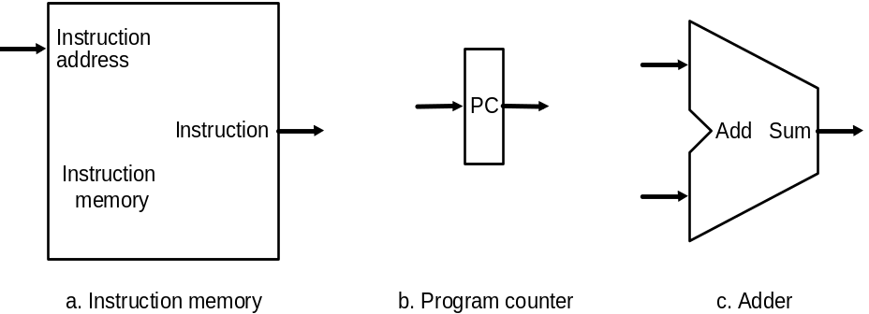
Datapath: Instruction Store/Fetch & PC Increment
Three elements used to store
and fetch instructions and
increment the PC
Datapath

Slide 11
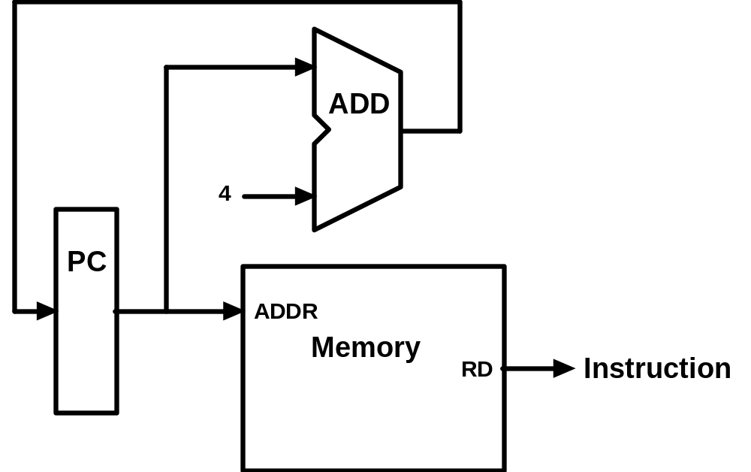
Animating the Datapath
Instruction <- MEM[PC]
PC <- PC + 4

Slide 12
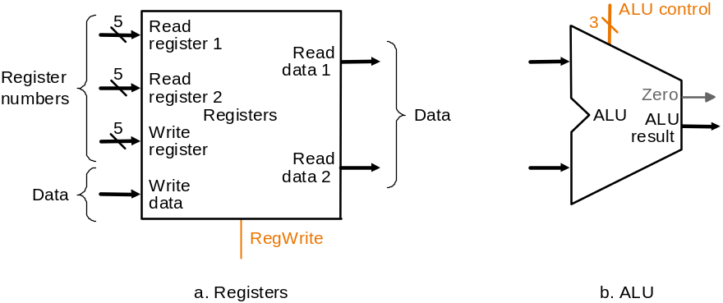
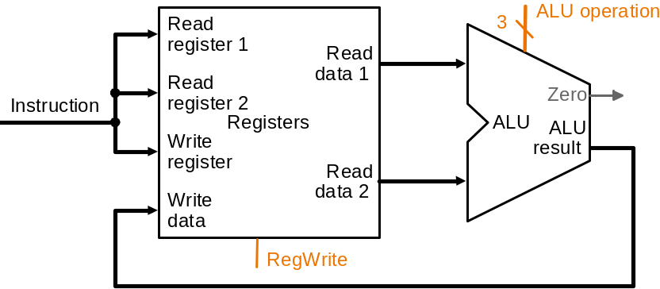
Datapath: R-Type Instruction
Two elements used to implement
R-type instructions
Datapath

Slide 13
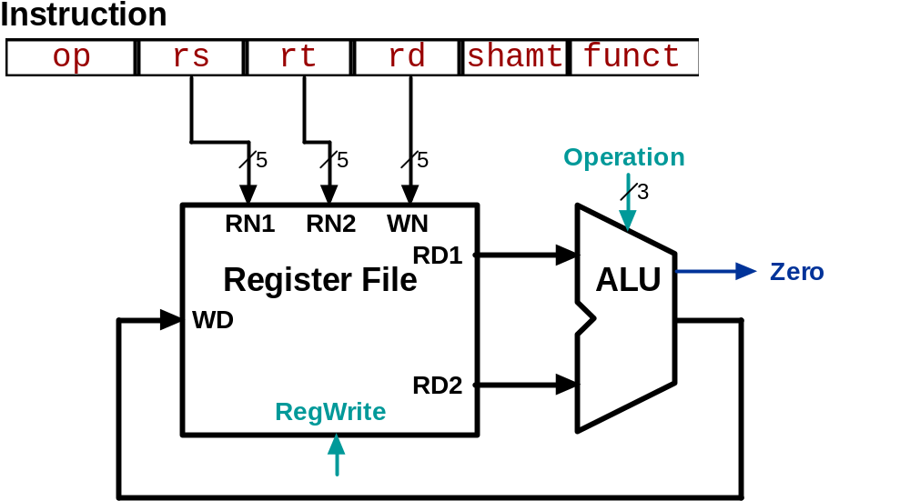
Animating the Datapath
add rd, rs, rt
R[rd] <- R[rs] + R[rt];

Slide 14
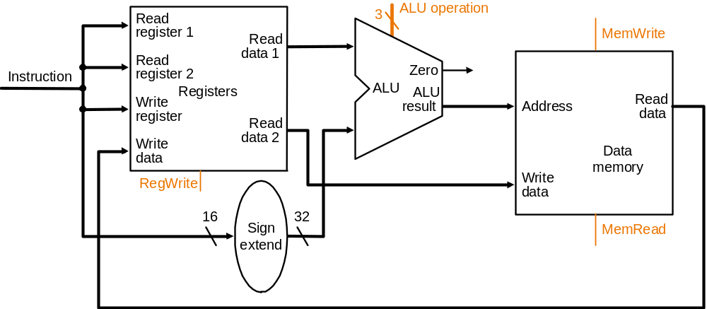
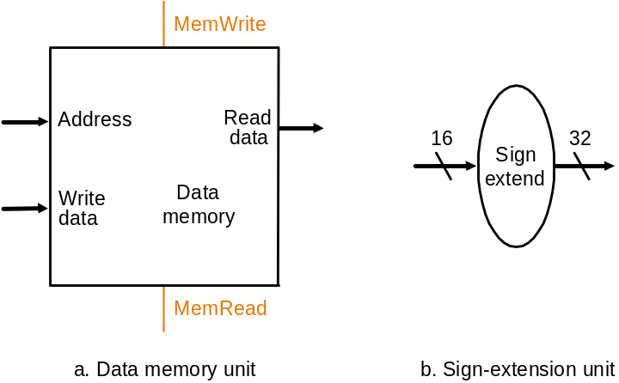
Datapath:
Load/Store Instruction
Two additional elements used
To implement load/stores
Datapath

Slide 15
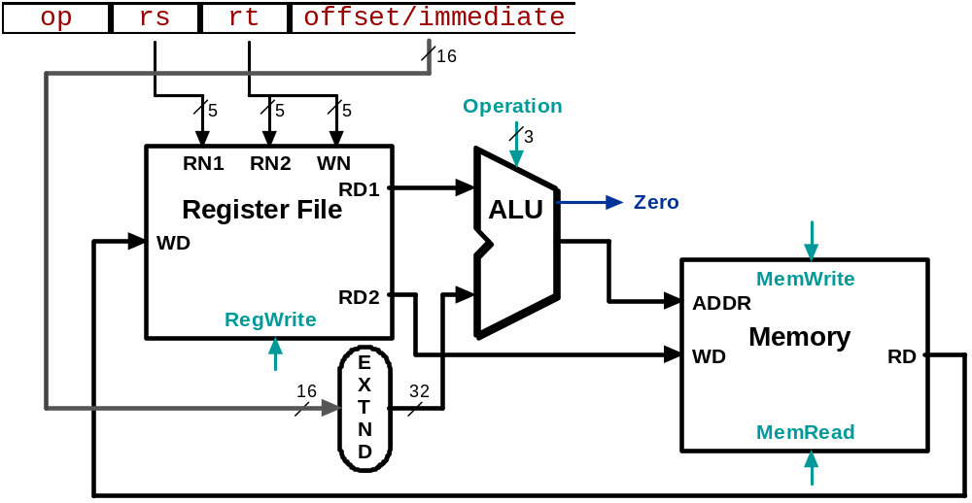
Animating the Datapath
lw rt, offset(rs)
R[rt] <- MEM[R[rs] + s_extend(offset)];

Slide 16
Animating the Datapath
sw rt, offset(rs)
MEM[R[rs] + sign_extend(offset)] <- R[rt]

Slide 17
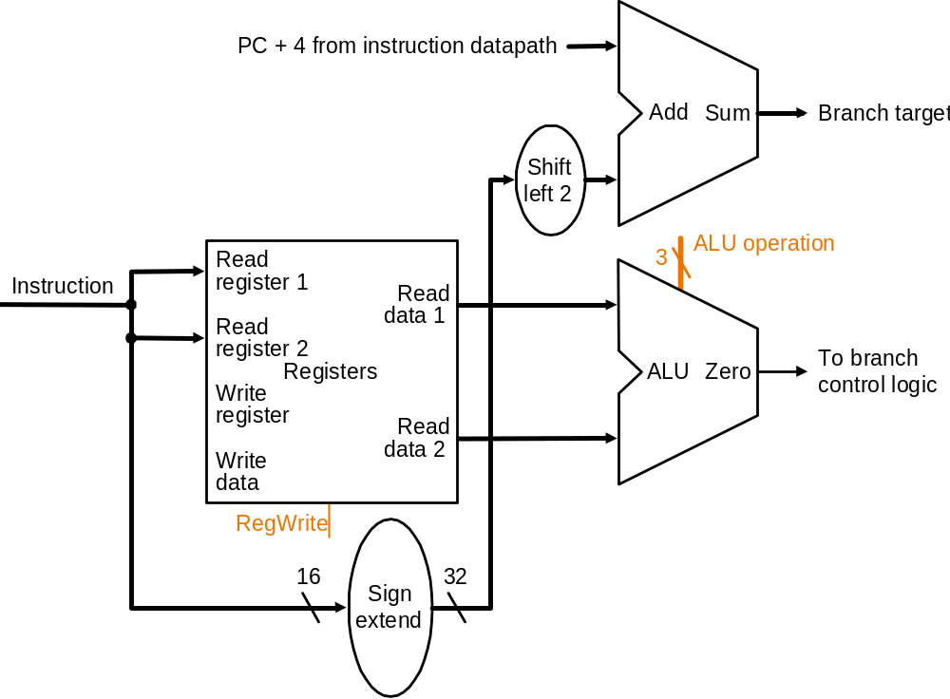
Datapath: Branch Instruction
No shift hardware required:
simply connect wires from
input to output, each shifted
left 2 bits
Datapath

Slide 18
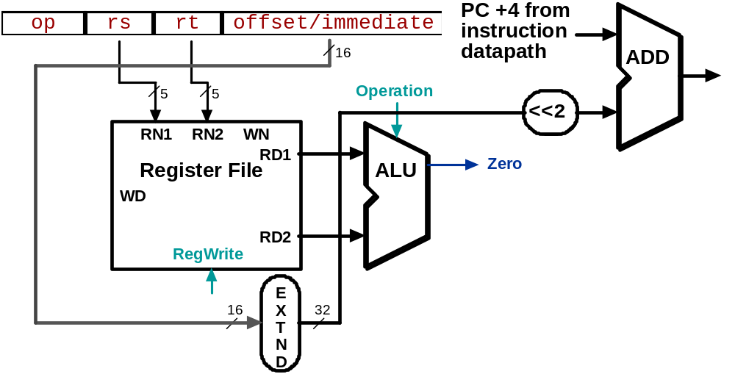
Animating the Datapath
beq rs, rt, offset
  if (R[rs] == R[rt]) then
  PC <- PC+4 + s_extend(offset<<2)

Slide 19
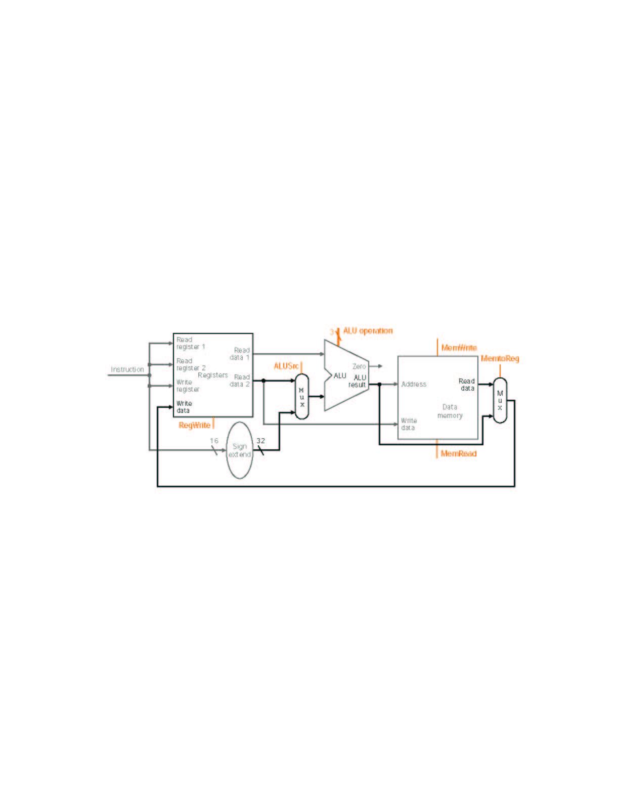
MIPS Datapath I: Single-Cycle
Input is either register (R-type) or sign-extended
lower half of instruction (load/store)
Data is either
from ALU (R-type)
or memory (load)
Combining the datapaths for R-type instructions
and load/stores using two multiplexors

Slide 20
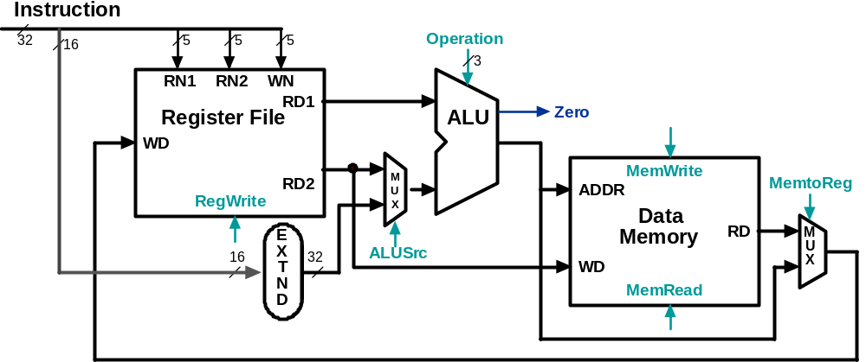
Animating the Datapath:
R-type Instruction
add rd,rs,rt

Slide 21
Animating the Datapath:
Load Instruction
lw rt,offset(rs)

Slide 22
Animating the Datapath:
Store Instruction
sw rt,offset(rs)

Slide 23
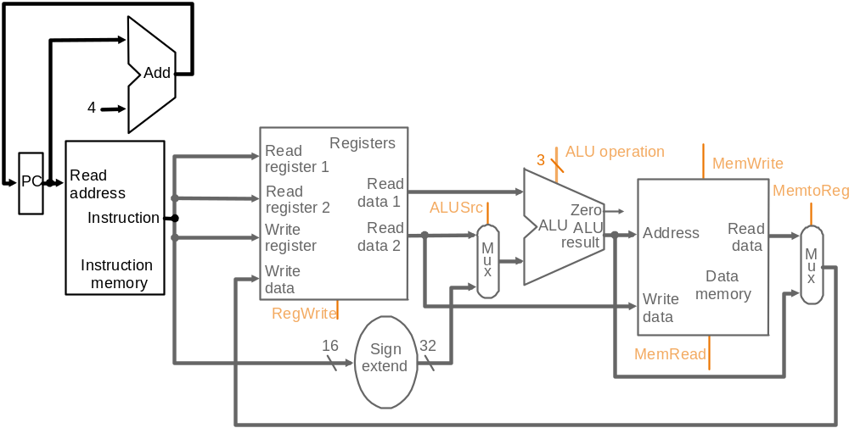
MIPS Datapath II: Single-Cycle
Separate adder as ALU operations and PC
increment occur in the same clock cycle
Separate instruction memory
as instruction and data read
occur in the same clock cycle
Adding instruction fetch

Slide 24
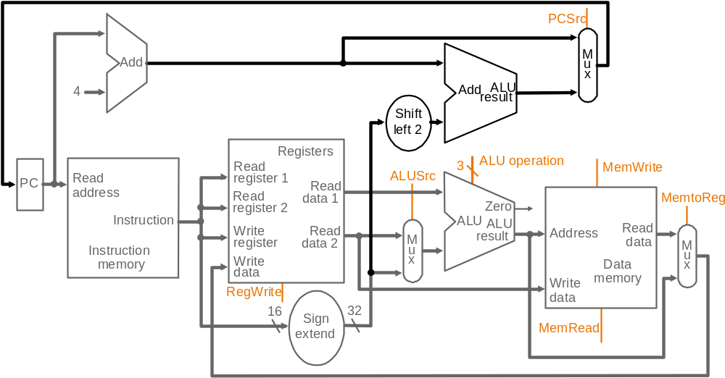
MIPS Datapath III: Single-Cycle
New multiplexor
Extra adder needed as both
adders operate in each cycle
Instruction address is either
PC+4 or branch target address
Adding branch capability and another multiplexor
Important note: in a single-cycle implementation data cannot be stored
during an instruction – it only moves through combinational logic
Question: is the MemRead signal really needed?! Think of RegWrite…!

Slide 25
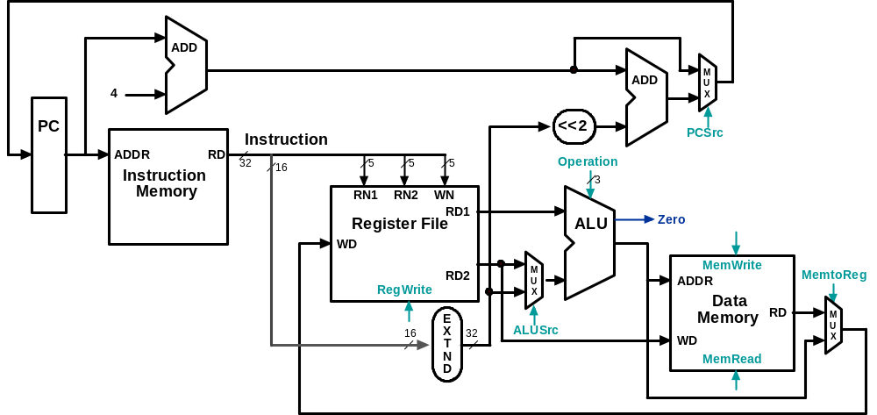
Datapath Executing add
add rd, rs, rt

Slide 26
Datapath Executing lw
lw rt,offset(rs)

Slide 27
Datapath Executing sw
sw rt,offset(rs)

Slide 28
Datapath Executing beq
beq r1,r2,offset

Slide 29
Control
Control unit takes input from
  the instruction opcode bits
Control unit generates
  ALU control input
  write enable (possibly, read enable also) signals for each storage element
  selector controls for each multiplexor

Slide 30
ALU Control
Plan to control ALU: main control sends a 2-bit ALUOp control field to the ALU control. Based on ALUOp and funct field of instruction the ALU control generates the 4-bit ALU control field
  ALU control Func-
field tion
0000 and
0001 or
0010 add
0110 sub
0111 slt
1100 NOR
ALU must perform
  add for load/stores (ALUOp 00)
  sub for branches (ALUOp 01)
  one of and, or, add, sub, slt for R-type instructions, depending on the instruction’s 6-bit funct field (ALUOp 10)
2
ALUOp
4
Main
Control
ALU
Control
To
ALU
ALU
control
input
6
Instruction
funct field
ALUOp generation
by main control

Slide 31
Setting ALU Control Bits
Instruction AluOp Instruction Funct Field Desired ALU control
opcode operation ALU action input
LW 00 load word xxxxxx add 0010
SW 00 store word xxxxxx add 0010
Branch eq 01 branch eq xxxxxx subtract 0110
R-type 10 add 100000 add 0010
R-type 10 subtract 100010 subtract 0110
R-type 10 AND 100100 and 0000
R-type 10 OR 100101 or 0001
R-type 10 set on less 101010 set on less 0111
ALUOp
Funct field
Operation
ALUOp1
ALUOp0
F5
F4
F3
F2
F1
F0
0
0
X
X
X
X
X
X
010
*
0
1
X
X
X
X
X
X
110
1
X
X
X
0
0
0
0
010
1
X
X
X
0
0
1
0
110
1
X
X
X
0
1
0
0
000
1
X
X
X
0
1
0
1
001
1
X
X
X
1
0
1
0
111
Truth table for ALU control bits

Slide 32
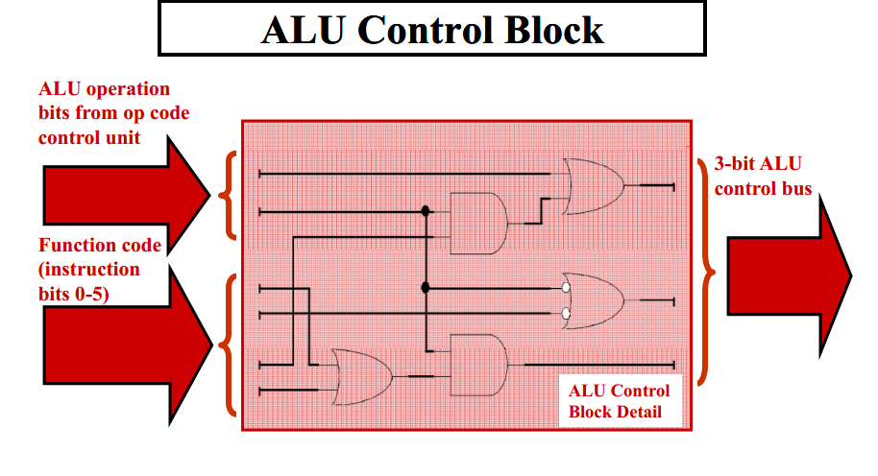

Slide 33
Designing the Main Control
R-type
opcode
rs
rt
rd
shamt
funct
31-26
25-21
20-16
15-11
10-6
5-0
Load/store
or branch
opcode
rs
rt
address
31-26
25-21
20-16
15-0
Observations about MIPS instruction format
  opcode is always in bits 31-26
  two registers to be read are always rs (bits 25-21) and rt (bits 20-16)
  base register for load/stores is always rs (bits 25-21)
  16-bit offset for branch equal and load/store is always bits 15-0
  destination register for loads is in bits 20-16 (rt) while for R-type instructions it is in bits 15-11 (rd) (will require multiplexor to select)

Slide 34
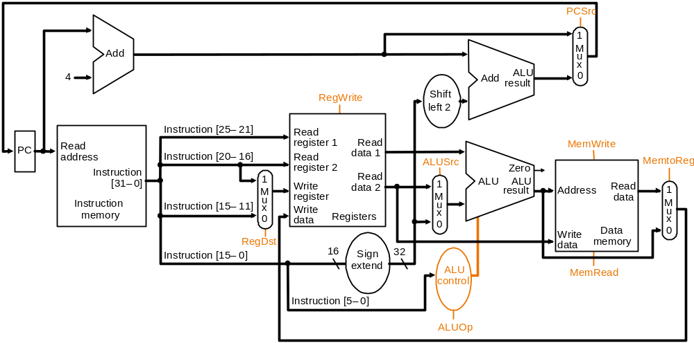
Datapath with Control I
New multiplexor
Adding control to the MIPS Datapath III (and a new multiplexor to select field to
specify destination register): what are the functions of the 9 control signals?

Slide 35
Control Signals
Signal Name Effect when deasserted Effect when asserted
RegDst The register destination number for the The register destination number for the
Write register comes from the rt field (bits 20-16) Write register comes from the rd field (bits 15-11)
RegWrite None The register on the Write register input is written
with the value on the Write data input
AlLUSrc The second ALU operand comes from the The second ALU operand is the sign-extended,
second register file output (Read data 2) lower 16 bits of the instruction
PCSrc The PC is replaced by the output of the adder The PC is replaced by the output of the adder
that computes the value of PC + 4 that computes the branch target
MemRead None Data memory contents designated by the address
input are put on the first Read data output
MemWrite None Data memory contents designated by the address
input are replaced by the value of the Write data input
MemtoReg The value fed to the register Write data input The value fed to the register Write data input
comes from the ALU comes from the data memory
Effects of the seven control signals

Slide 36
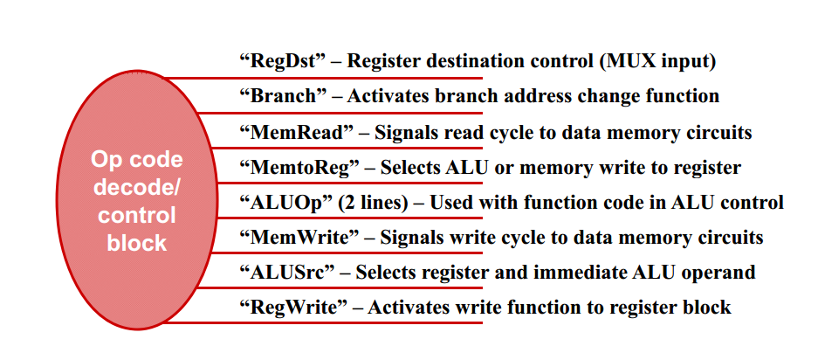

Slide 37
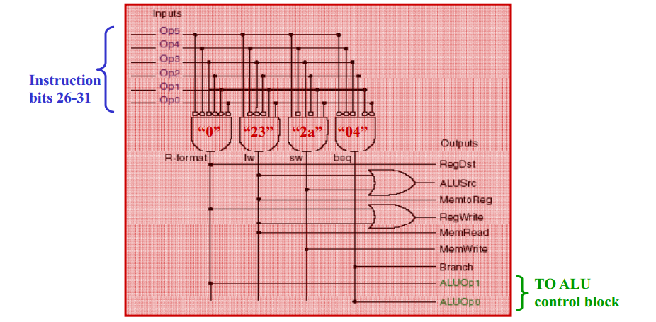
Main control unit

Slide 38
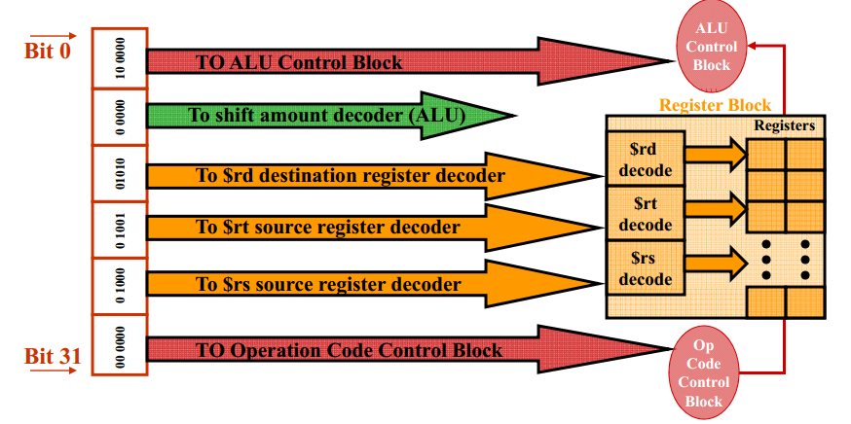
Instruction disposition
Chapter 4 — The Processor — <number>

Slide 39
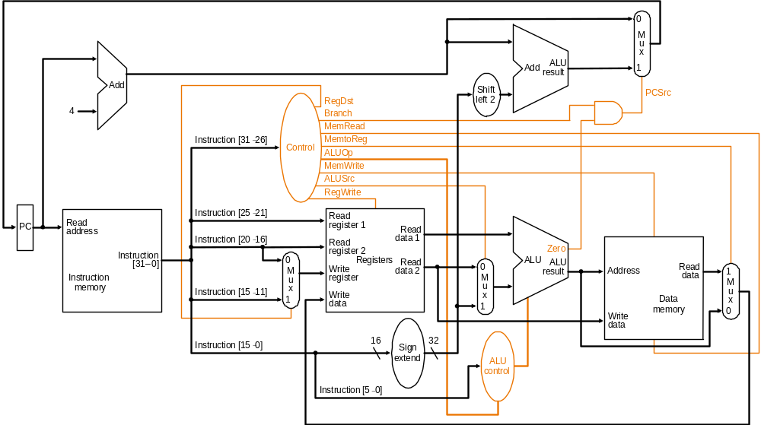
Datapath with Control II
MIPS datapath with the control unit: input to control is the 6-bit instruction
opcode field, output is seven 1-bit signals and the 2-bit ALUOp signal

Slide 40
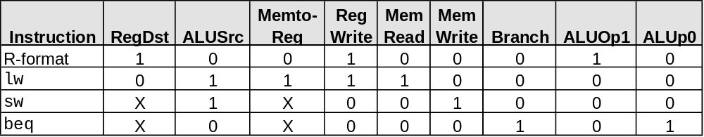
Datapath with
Control II (cont.)
PCSrc cannot be
set directly from the
opcode: zero test
outcome is required
Determining control signals for the MIPS datapath based on instruction opcode

Slide 41
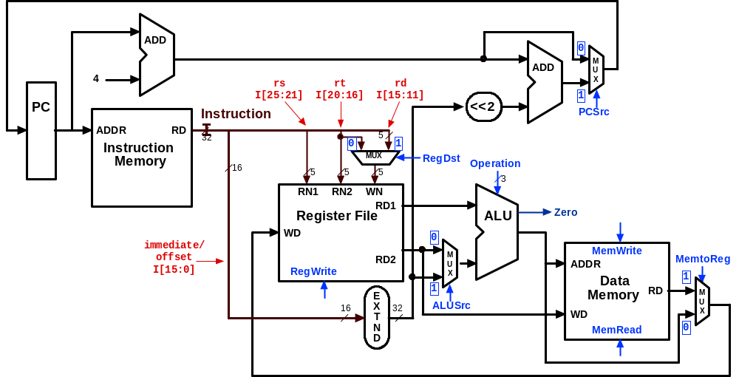
Control Signals:
R-Type Instruction
0
???
Value depends on funct
1
0
0
1
Control signals
shown in blue
0
0

Slide 42
Control Signals: lw Instruction
0
010
0
0
1
1
Control signals
shown in blue
1
1

Slide 43
Control Signals: sw Instruction
0
010
X
1
X
0
Control signals
shown in blue
1
0

Slide 44
Control Signals: beq Instruction
1 if Zero=1
110
X
0
X
0
Control signals
shown in blue
0
0

Slide 45
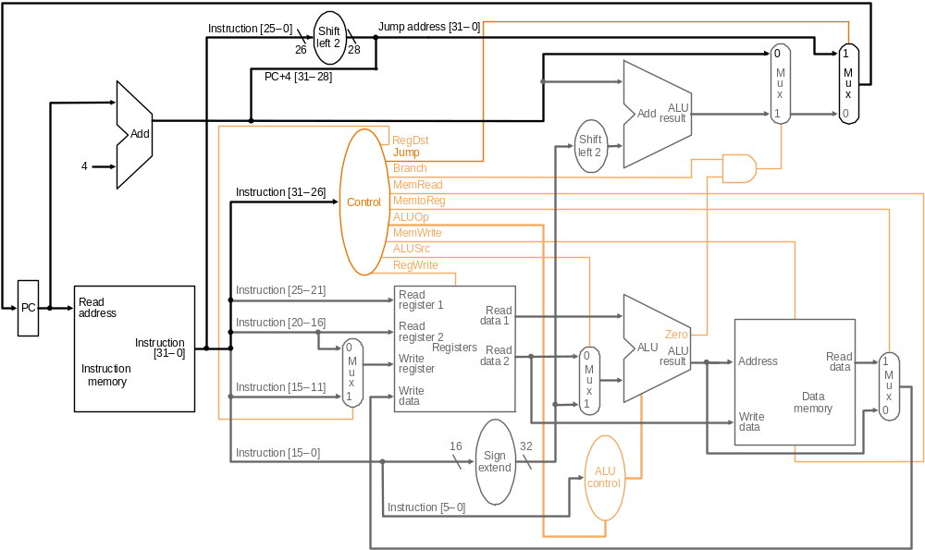
Datapath with Control III
Jump
opcode
address
31-26
Composing jump
target address
25-0
New multiplexor with additional
control bit Jump
MIPS datapath extended to jumps: control unit generates new Jump control bit

Slide 46
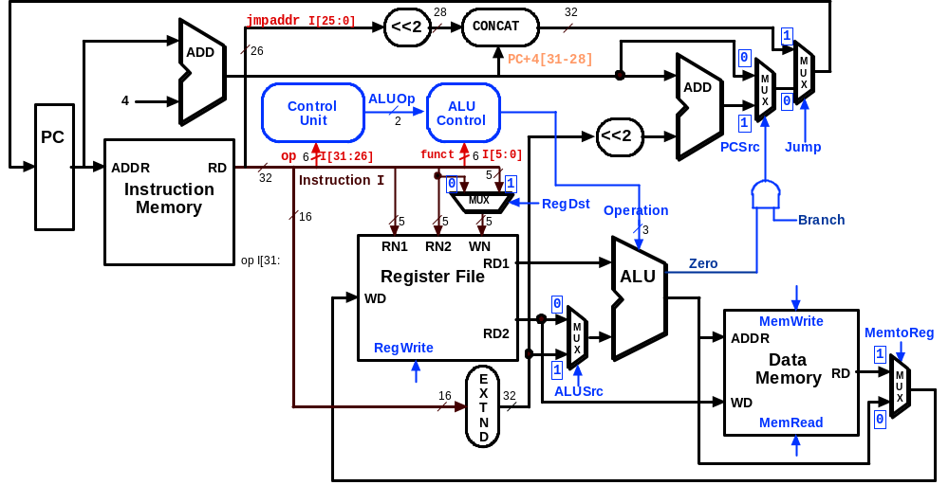
Datapath Executing j

Slide 47
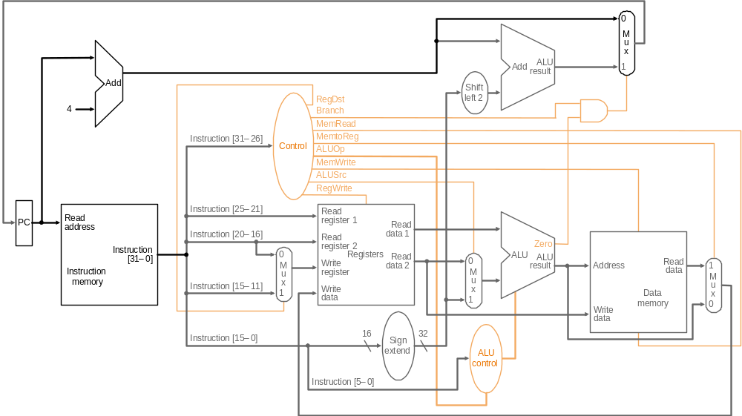
R-type Instruction: Step 1 add $t1, $t2, $t3 (active = bold)
Fetch instruction and increment PC count

Slide 48
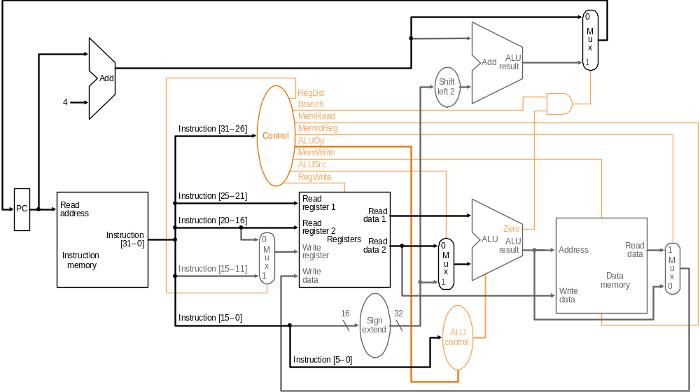
R-type Instruction: Step 2 add $t1, $t2, $t3 (active = bold)
Read two source registers from the register file

Slide 49
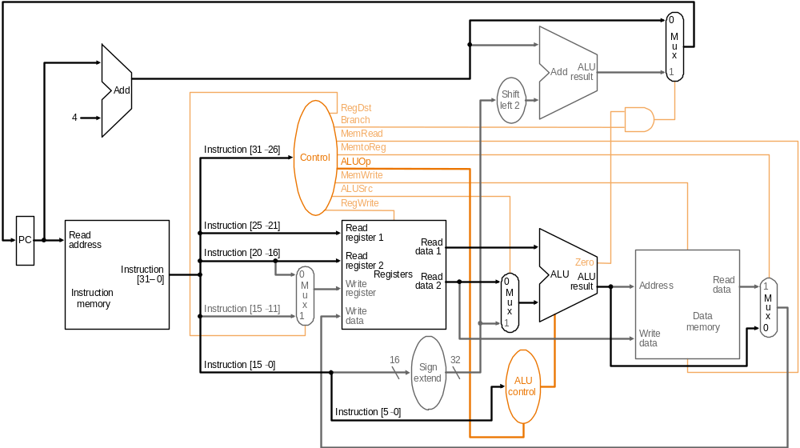
R-type Instruction: Step 3 add $t1, $t2, $t3 (active = bold)
ALU operates on the two register operands

Slide 50
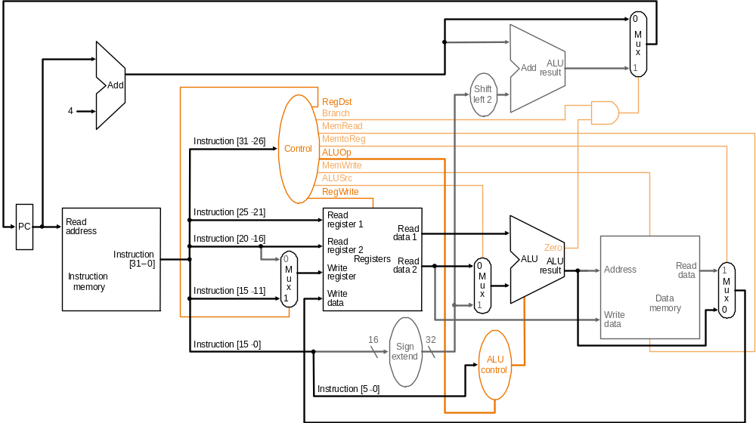
R-type Instruction: Step 4 add $t1, $t2, $t3 (active = bold)
Write result to register

Slide 51
Single-cycle Implementation Notes
The steps are not really distinct as each instruction completes in exactly one clock cycle – they simply indicate the sequence of data flowing through the datapath
The operation of the datapath during a cycle is purely combinational – nothing is stored during a clock cycle
Therefore, the machine is stable in a particular state at the start of a cycle and reaches a new stable state only at the end of the cycle
Very important for understanding single-cycle computing:

Slide 52
Load Instruction Steps lw $t1, offset($t2)
Fetch instruction and increment PC
Read base register from the register file: the base register ($t2) is given by bits 25-21 of the instruction
ALU computes sum of value read from the register file and the sign-extended lower 16 bits (offset) of the instruction
The sum from the ALU is used as the address for the data memory
The data from the memory unit is written into the register file: the destination register ($t1) is given by bits 20-16 of the instruction

Slide 53
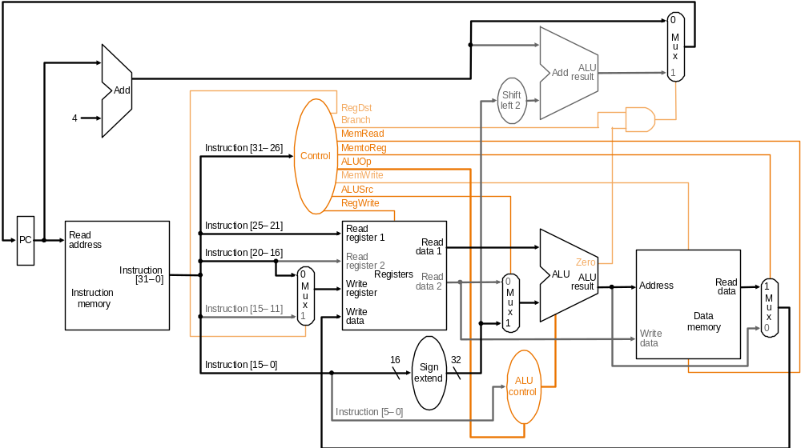
Load Instruction lw $t1, offset($t2)

Slide 54
Branch Instruction Steps beq $t1, $t2, offset
Fetch instruction and increment PC
Read two register ($t1 and $t2) from the register file
ALU performs a subtract on the data values from the register file; the value of PC+4 is added to the sign-extended lower 16 bits (offset) of the instruction shifted left by two to give the branch target address
The Zero result from the ALU is used to decide which adder result (from step 1 or 3) to store in the PC

Slide 55
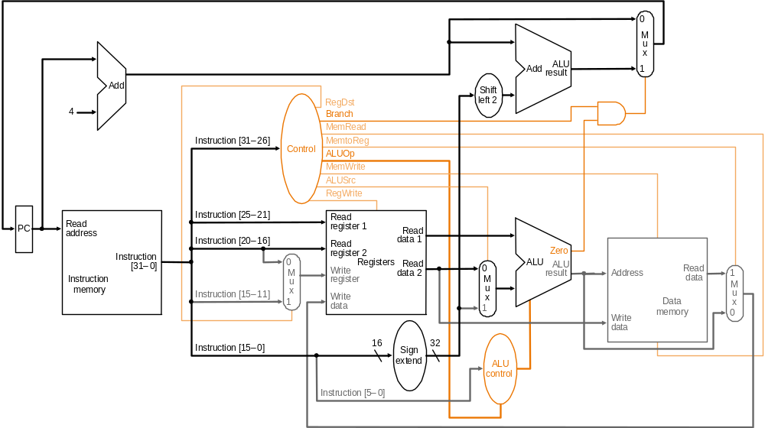
Branch Instruction beq $t1, $t2, offset

Slide 56
Assume time for stages is
  100ps for register read or write
  200ps for other stages
Instr | Instr fetch | Register read | ALU op | Memory access | Register write | Total time
lw | 200ps | 100 ps | 200ps | 200ps | 100 ps | 800ps
sw | 200ps | 100 ps | 200ps | 200ps |  | 700ps
R-format | 200ps | 100 ps | 200ps |  | 100 ps | 600ps
beq | 200ps | 100 ps | 200ps |  |  | 500ps
Chapter 4 — The Processor — <number>
Notes:
Morgan Kaufmann Publishers
Chapter 4 — The Processor

Slide 57
Single-Cycle Design: disadvantage
Assuming fixed-period clock every instruction data-path uses one clock cycle implies:
  CPI = 1
  cycle time determined by length of the longest instruction path (load)
    but several instructions could run in a shorter clock cycle: waste of time
  resources used more than once in the same cycle need to be duplicated
    waste of hardware and chip area

Slide 58
Fixing the problem with single-cycle designs
One solution: a variable-period clock with different cycle times for each instruction class
  unfeasible, as implementing a variable-speed clock is technically difficult
Another solution:
  use a smaller cycle time…
  …have different instructions take different numbers of cycles
  by breaking instructions into steps and fitting each step into one cycle
  feasible: multicyle approach!

Slide 59
Multi cycle implementation
An implementation in which an instruction is executed in executed in multiple clock cycle
Break up the instructions into steps
  each step takes one clock cycle
  It allows a functional unit to be used more than once per instruction, since it is used on different clock
  This Sharing can reduce amount of hardware required

Slide 60
Multi-cycle design:Advantages
The ability to allow instructions to take different numbers of clock cycles
The ability to share functional units with in the execution of a single instruction

Slide 61
Single-cycle datapath

Slide 62
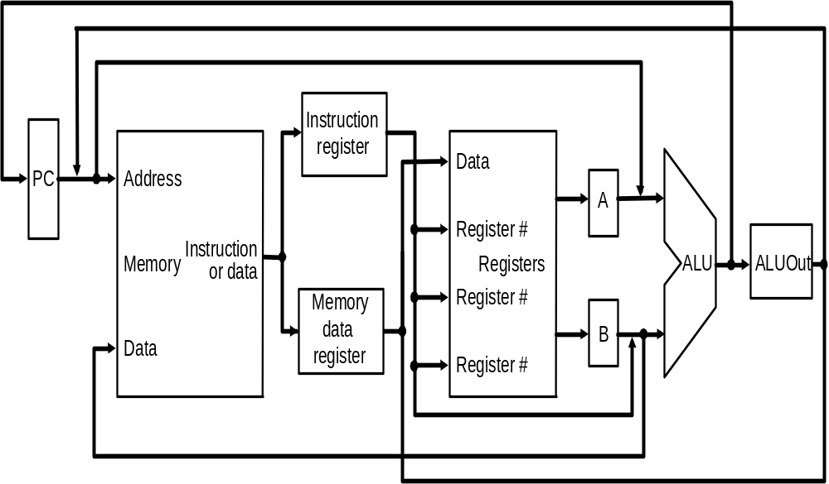
Multi-cycle : abstract implementation

Slide 63
Multicycle Vs single cycle
Note particularities of multicyle vs. single-cycle diagrams
  single memory for data & instructions
  single ALU, no extra adders
  extra registers to hold data between
  clock cycles
Data used by same instruction in a later cycle must be stored into additional registers

Slide 64
Internal registers
Between steps/cycles
  At the end of one cycle store data to be used in later cycles of the same instruction
    need to introduce additional internal (programmer-invisible) registers for this purpose
Temporary registers are
  Instruction Registers (IR), Memory Data Register (MDR) to save output of memory
  Registers A, B to hold register operands

Slide 65
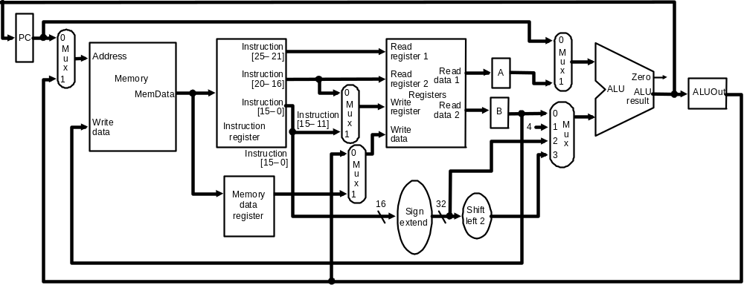
Multicycle Datapath
Basic multicycle MIPS datapath handles R-type instructions and load/stores:
new internal register in red ovals, new multiplexors in blue ovals

Slide 66
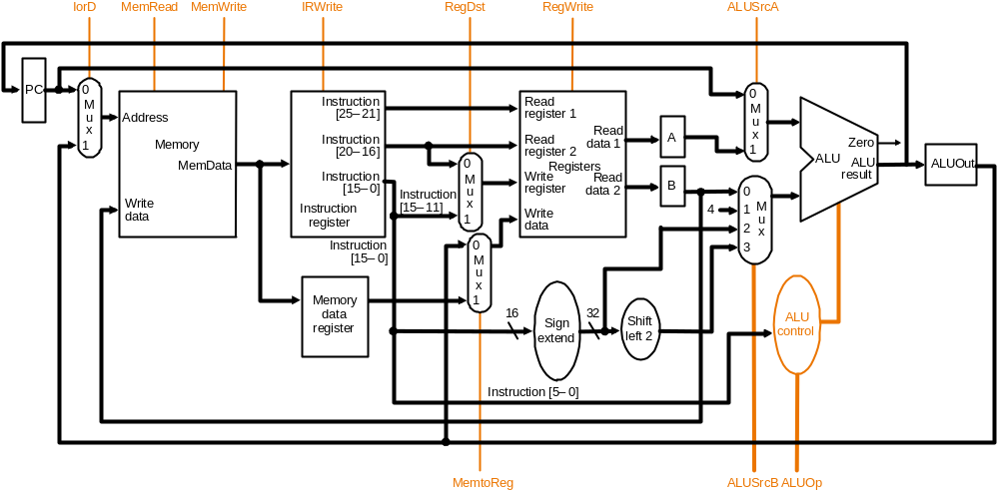
Multicycle Datapath with Control I
… with control lines and the ALU control block added – not all control lines are shown

Slide 67
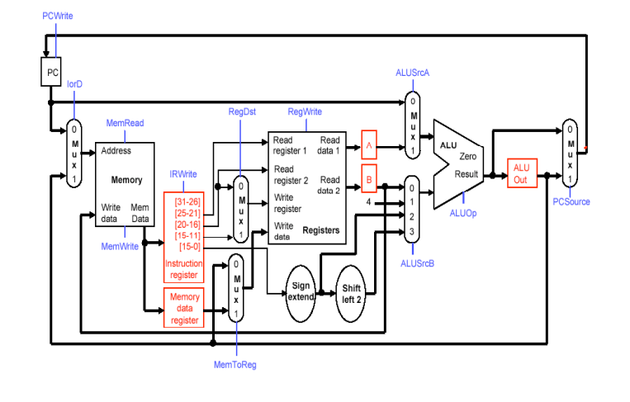
Multi cycle data path with control signals.

Slide 68
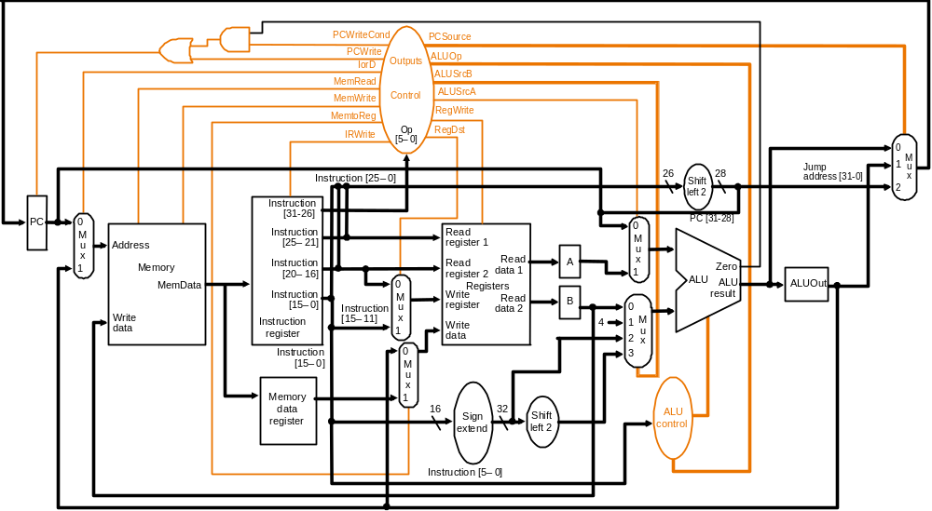
Multicycle Datapath with Control II
New gates
For the jump address
New multiplexor
Complete multicycle MIPS datapath (with branch and jump capability)
and showing the main control block and all control lines

Slide 69
Breaking instructions into steps
Our goal is to break up the instructions into steps so that
  each step takes one clock cycle
  each cycle uses at most once each major functional unit so that such units do not have to be replicated
  functional units can be shared between different cycles within one instruction
Data at end of one cycle to be used in next must be stored !!

Slide 70
We attempt to keep the amount of work per cycle roughly equal.
  Restrict each step to contain at most
    One ALU operation
    One register file access
    One memory access
With this restriction clock cycle could be as short as the longest of these operations.

Slide 71
Breaking instructions into steps
We break instructions into the following potential execution steps ;each step takes one clock cycle
  Instruction fetch and PC increment (IF)
  Instruction decode and register fetch (ID)
  Execution, memory address computation, or branch completion (EX)
  Memory access or R-type instruction completion (MEM)
  Writing data back to register file(WB)
Each MIPS instruction takes from 3 – 5 cycles (steps)

Slide 72
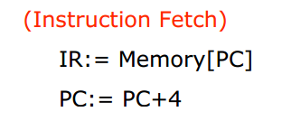
Step 1: Instruction Fetch & PC Increment (IF)
Use PC to get instruction and put it in the instruction register.
Increment the PC by 4 and put the result back in the PC.

Slide 73
Step 2: Instruction Decode and Register Fetch (ID)
Read registers rs and rt in case we need them.
Compute the branch address in case the instruction is a branch.
A = Reg[IR[25-21]];
B = Reg[IR[20-16]];
ALUOut = PC + (sign-extend(IR[15-0]) << 2);

Slide 74
Step 3: Execution, Address Computation or Branch Completion (EX)
ALU performs one of four functions depending on instruction type
  memory reference:
  ALUOut = A + sign-extend(IR[15-0]);
  R-type:
  ALUOut = A op B;
  branch (instruction completes):
  if (A==B) PC = ALUOut;
  jump (instruction completes):
  PC = PC[31-28] || (IR(25-0) << 2)

Slide 75
Step 4: Memory access or R-type Instruction Completion
(MEM)
Again depending on instruction type:
Loads and stores access memory
  load
  MDR = Memory[ALUOut];
  store (instruction completes)
  Memory[ALUOut] = B;
R-type (instructions completes)
Reg[IR[15-11]] = ALUOut;

Slide 76
Step 5: Memory Read Completion (WB)
Again depending on instruction type:
Load writes back (instruction completes)
Reg[IR[20-16]]= MDR;
Important: There is no reason from a datapath (or control) point of view that Step 5 cannot be eliminated by performing
Reg[IR[20-16]]= Memory[ALUOut]; for loads in Step 4. This would eliminate the MDR as well.
The reason this is not done is that, to keep steps balanced in length, the design restriction is to allow each step to contain at most one ALU operation, or one register access, or one memory access.

Slide 77
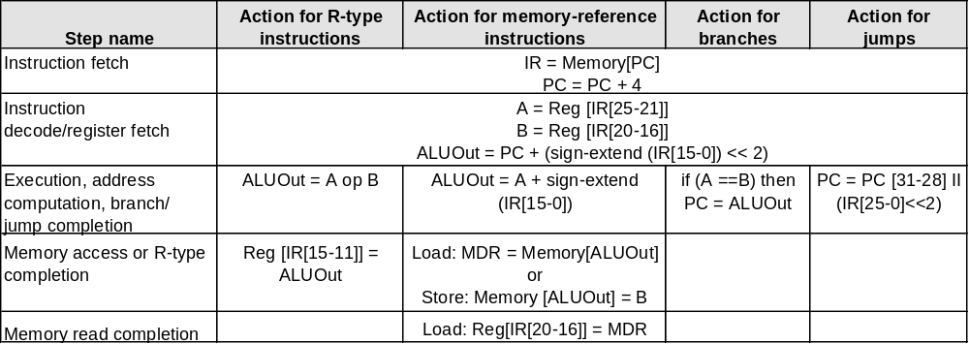
Summary of Instruction Execution
Step
1: IF
2: ID
3: EX
4: MEM
5: WB

Slide 78
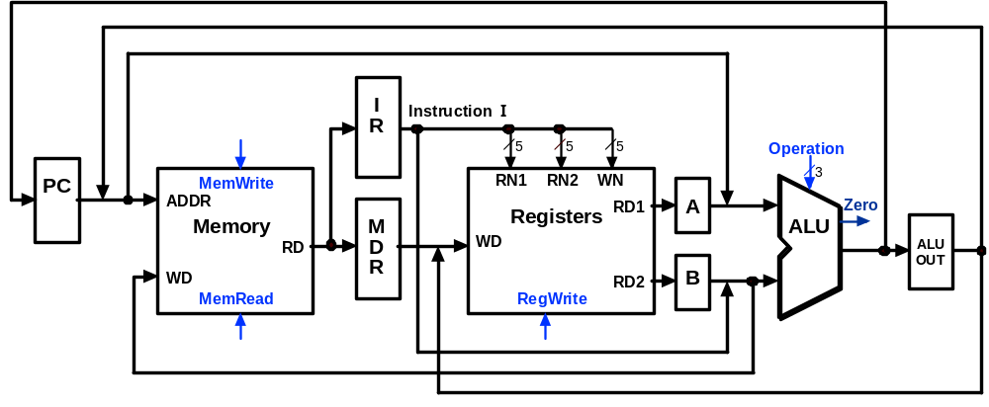
Multicycle Execution Step (1):
Instruction Fetch
IR = Memory[PC];
PC = PC + 4;
4
PC + 4

Slide 79
Multicycle Execution Step (2):
Instruction Decode & Register Fetch
A = Reg[IR[25-21]]; (A = Reg[rs])
B = Reg[IR[20-15]]; (B = Reg[rt])
ALUOut = (PC + sign-extend(IR[15-0]) << 2)
Reg[rs]
Branch
Target
Address
PC + 4
Reg[rt]

Slide 80
Multicycle Execution Step (3):
Memory Reference Instructions
ALUOut = A + sign-extend(IR[15-0]);
Reg[rs]
Mem.
Address
PC + 4
Reg[rt]

Slide 81
Multicycle Execution Step (3):
ALU Instruction (R-Type)
ALUOut = A op B
Reg[rs]
R-Type
Result
PC + 4
Reg[rt]

Slide 82
Multicycle Execution Step (3):
Branch Instructions
if (A == B) PC = ALUOut;
Reg[rs]
Branch
Target
Address
Branch
Target
Address
Reg[rt]

Slide 83
Multicycle Execution Step (3):
Jump Instruction
PC = PC[31-28] concat (IR[25-0] << 2)
Reg[rs]
Branch
Target
Address
Jump
Address
Reg[rt]

Slide 84
Multicycle Execution Step (4):
Memory Access - Read (lw)
MDR = Memory[ALUOut];
Reg[rs]
Mem.
Address
PC + 4
Mem.
Data
Reg[rt]

Slide 85
Multicycle Execution Step (4):
Memory Access - Write (sw)
Memory[ALUOut] = B;
Reg[rs]
PC + 4
Reg[rt]

Slide 86
Multicycle Execution Step (4):
ALU Instruction (R-Type)
Reg[IR[15:11]] = ALUOUT
Reg[rs]
R-Type
Result
PC + 4
Reg[rt]

Slide 87
Multicycle Execution Step (5):
Memory Read Completion (lw)
Reg[IR[20-16]] = MDR;
Reg[rs]
Mem.
Address
PC + 4
Mem.
Data
Reg[rt]

Slide 88
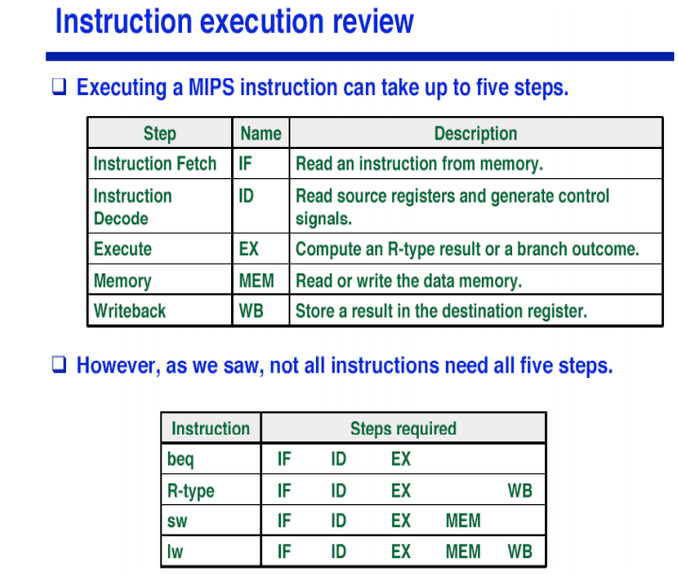

Slide 89
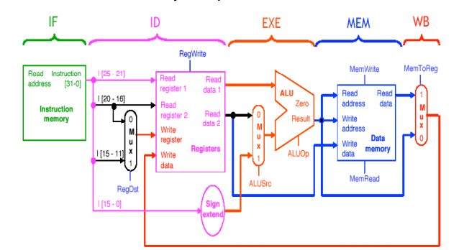
Break data path into 5 stages

